Slide 1
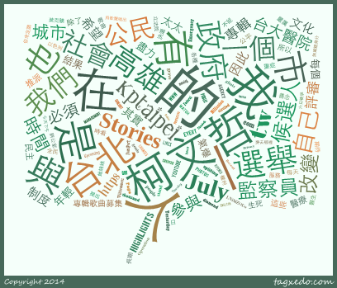
Assignment 6: Social Opinion Mining
輿論風向球 (Finding Top 100 high-correlated words co-appeared with the following names from Ptt 八卦版)
韓國瑜
蔡英文
賴清德
柯文哲
郭台銘

Slide 2
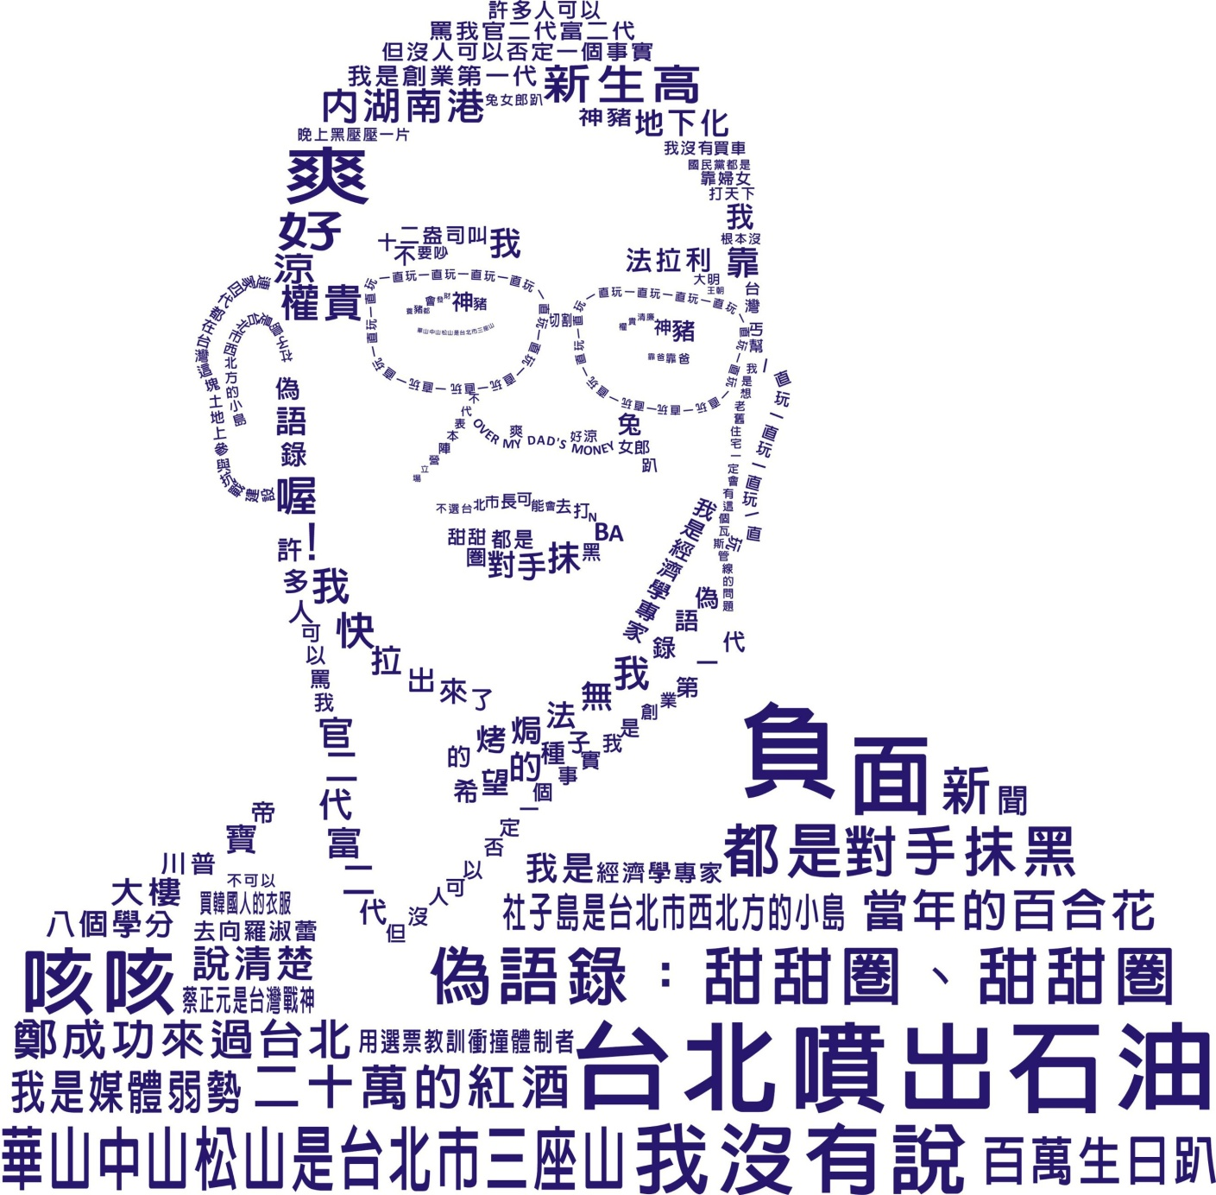

Slide 3
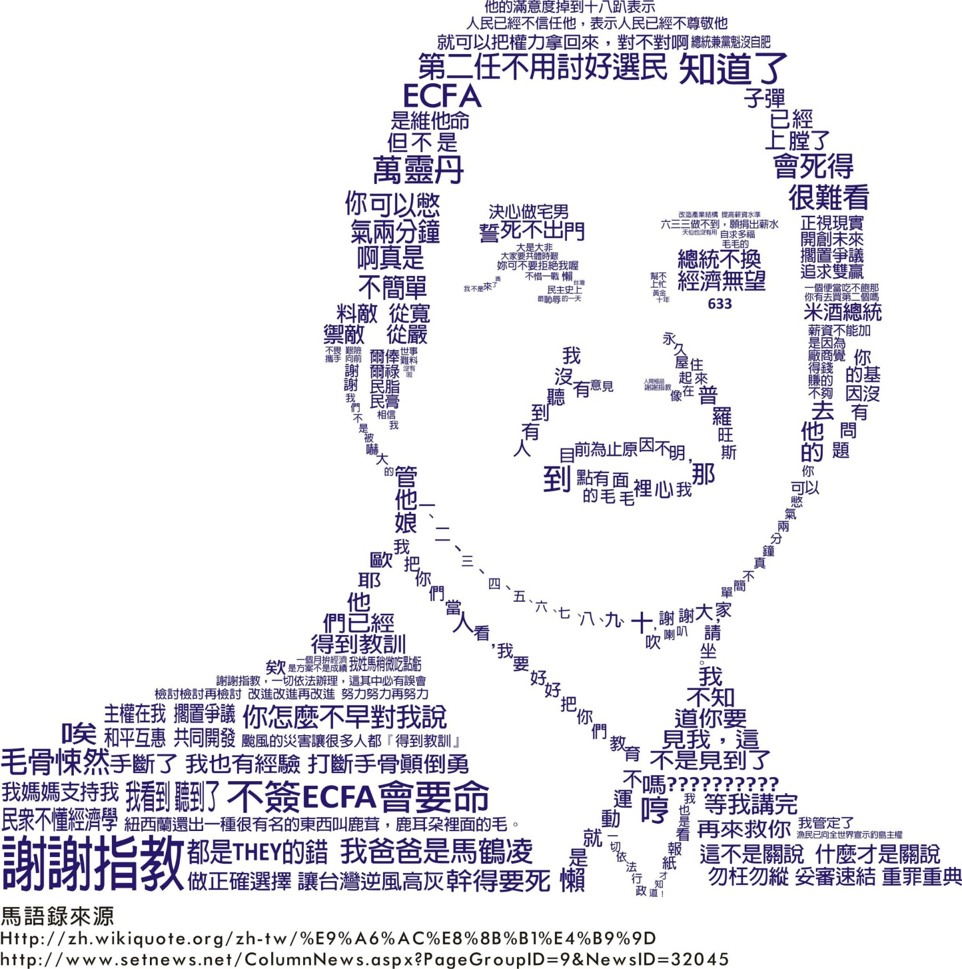

Slide 4
Assignment 5: Social Opinion Mining
Available tools:
Ptt Dataset Social Media Content
https://drive.google.com/file/d/1mxGoqyqOobCvFQYXRyoFYKSYhCD06d0u/view
Sentence Segmentation
Jieba (Java) (python)
Word Cloud Generator http://timdream.org/wordcloud/
Use X² (Chi-square Method) to find 100 high correlated keywords
Assignment Due 6/4
Make a Presentation for the word clouds for the politician you select

Slide 5
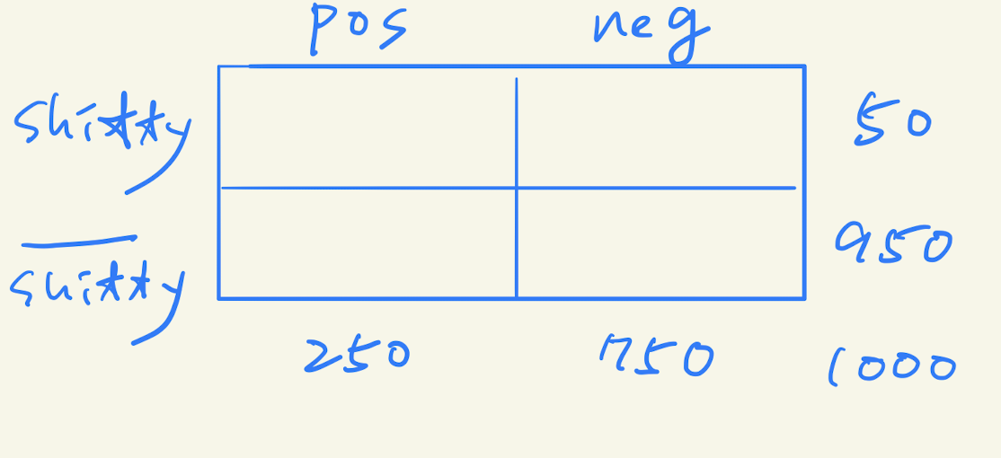
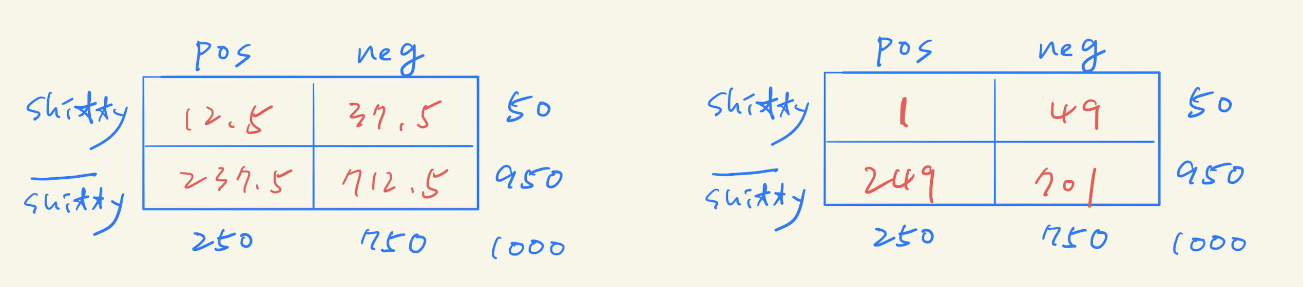
Assume that there are 1000 documents.
among the 1000 documents,
Pos. document #: 250
Neg. document #: 750
Also, the # of document containing “shitty”: 50
In other words, the # of document without “shitty”: 950
Chi-square score for “shitty”
Expectation
Observation
Notes:
\sum_{\forall i}\frac{E_i-O_i}{E_i}

Slide 6
